Slide 1
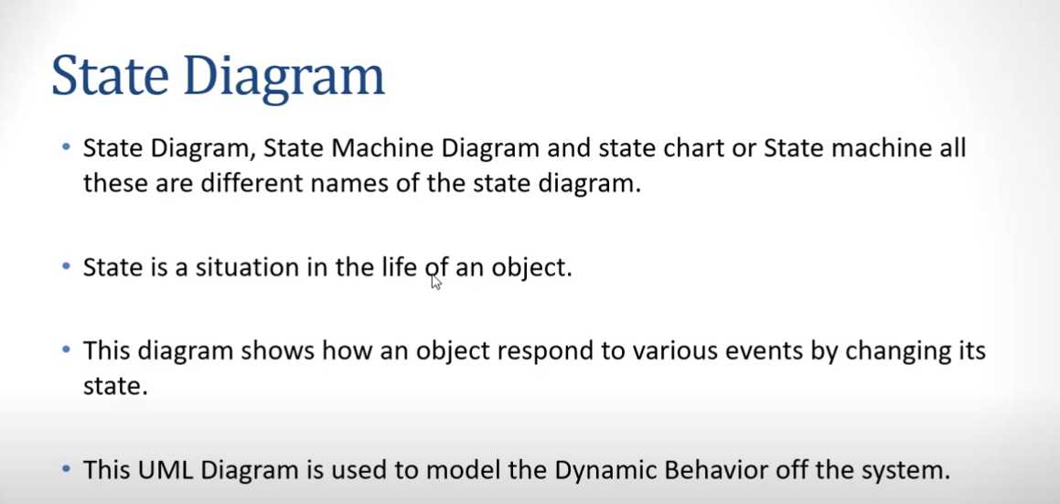

Slide 2
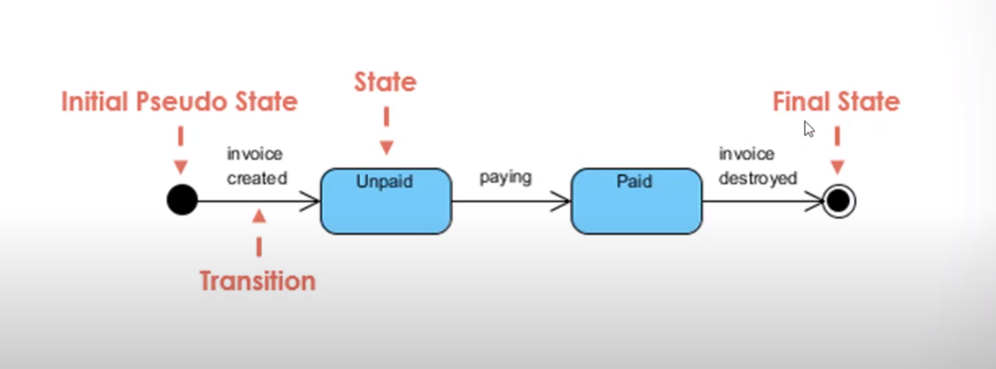

Slide 3
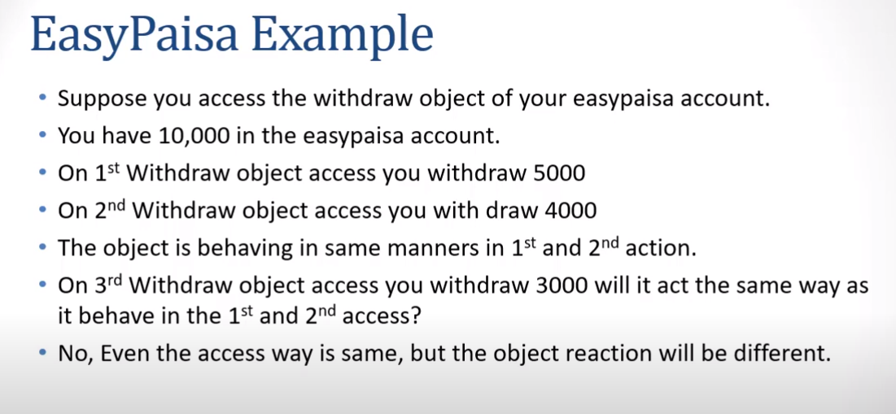

Slide 4
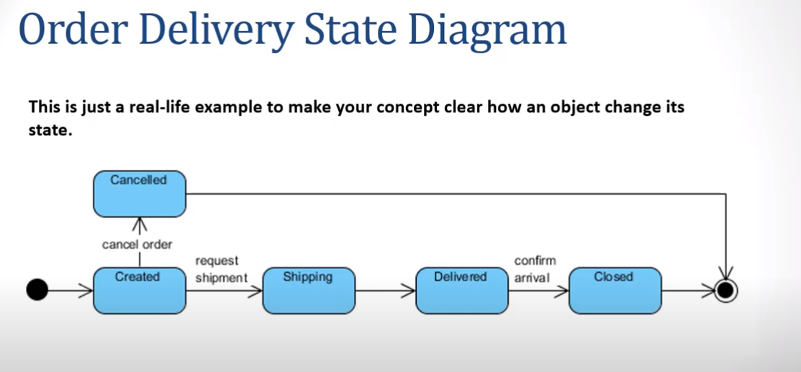

Slide 5
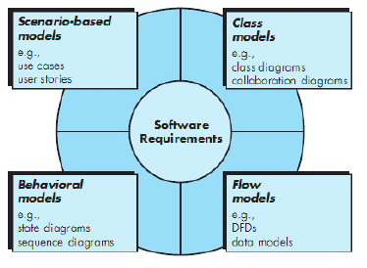
Elements in Analysis Model

Slide 6
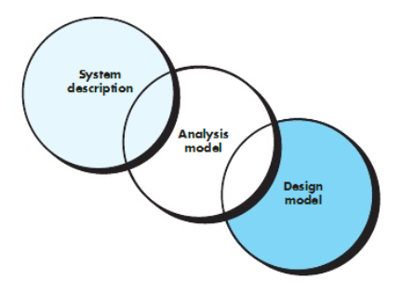
Analysis
Focus on requirements
Each element should improve understanding of requirements
Delay consideration of infrastructure till design
Requirements model provides value to all stakeholders
Keep the models simple

Slide 7
Prioritizing Requirements
Different stakeholders have different set of requirements
potential conflicting ideas
Need to prioritize requirements to resolve conflicts
Prioritization might separate requirements into three categories
essential: absolutely must be met
desirable: highly desirable but not necessary
optional: possible but could be eliminated

Slide 8
References
Pfleeger Book slides from UCF
Acknowledgement!
A few slides have been reused from UCF slides for the SE course

